Slide 1
Cost Effective Resource Provisioning Approach for Cloud Environments

Slide 2
Contents
Objective
Problem Statement
Motivation
Introduction
Existing System
Literature Survey
Architecture
Project Scope
Algorithm
Advantages
Software
Hardware
Application
References

Slide 3
Objective
To monitor and analyze cost pattern on cloud accounts To analyze usage of the cloud services and give suggestions for future plans according to the user s usage To give the suggestions about cost optimization and delivering cost containment To improve system performance and service quality

Slide 4
Problem Statement
To implement a scheme i.e. Cost Effective Resource Provisioning Approach for Cloud Environments to reduce the infrastructure cost of cloud usage and evaluate the performance of workloads on EC2 instances.

Slide 5
Motivation
The infrastructure resources of cloud computing can be widely distributed in different phases according to the needs of different users In the course of a cloud implementation users have the flexibility to choose the EC2 instance type that provides the appropriate mix of resources for the target application and workload The charges are applied on the basis of resource utilization but it is very high as most of them not used in an optimal way.
The main purpose of the system is to create private cloud test bed by using Amazon Account along with monitoring critical resources like RAM CPU memory bandwidth partition information running process information and utilization and swap usages etc Also recommend the price reduction strategy.

Slide 6
Introduction
Cost optimization is a major concern in cloud computing as owners of large IT infrastructures have to pay a large cost for resource utilization. The infrastructure resources of cloud computing can be widely distributed in different phases according to the needs of different users. In the course of a cloud, implementation users have the flexibility to choose the EC2 instance type that provides the appropriate mix of resources for the target application and workload. The charges are applied on the basis of resource utilization, but it is very high as most of them not used in an effective way.
The main purpose of the system is to create private cloud (test bed) by using (Amazon Account) along with monitoring critical resources like RAM, CPU, memory, bandwidth, partition information, running process information and utilization and swap usages etc. Also, recommend the price reduction strategy. The system also enables optimum utilization of cloud resource.

Slide 7
Existing System
The current expectation of the cloud market is, customers of AWS will increase by up to 25% depending on how frequently customers start and stop new EC2 instances. But certainly, lots of big companies are investing billions of money in buying cloud infrastructure which is not used in an optimal/effective way. This system is very expensive and they services provided by these systems are less are not very imperative.

Slide 8
Literature Survey
Sr. No. | Paper Name | Publication + Year | Author | Concept
1 | Joint Optimization of Computational Cost and Devices Energy for Task Offloading in Multi-Tier Edge-Clouds | IEEE- 2019 | Elie El Haber , Tri Minh Nguyen , Chadi Assi. | The authors have made an attempt to propose a low-complexity algorithm based on the successive convex approximation method to solve and obtain a high-quality solution and also present an inflation-based algorithm for obtaining a polynomial-time and efficient solution.
2 | "Cost-Aware Cloud Proﬁling, Prediction, and Provisioning as a Service | ,PUBLISHED BY THE IEEE COMPUTER SOCIET, 2017. | Ryan Chard,Kyle Chard,Rich Wolski,Ravi Madduri,Bryan Ng and Kris Bubendorfer,IanFoster | The paper discussed Scalable Cost-Aware Cloud Infrastructure Management and Provisioning (SCRIMP) a service-based system that enables application developers and users to reliably outsource the task of provisioning cloud infrastructure. It shows that by understanding application requirements, predicting dynamic market conditions, and automatically provisioning infrastructure according to user-deﬁned policies and real-time conditions that our approaches can reduce costs by an order of magnitude when using commercial clouds while also improving execution performance and eﬃciency.

Slide 9
Sr. No. | Paper Name | Publication + Year | Author | Concept
3 | Transferable Knowledge for Low-cost Decision Making in Cloud Environments | 2020 IEEE | Faiza Samreen, Gordon S Blair, Yehia Elkhatib | This paper has introduced and approach and evaluate it through extensive experimentation involving three real world applications over two major public cloud providers, namely Amazon and Google. Our evaluation shows that our novel two-mode TL scheme increases overall efficiency with a factor of 60% reduction in the time and cost of generating a new prediction model.
4 | Monetary Cost Optimizations for Hosting Workflow-as-a-Service in IaaS Clouds | 2016 IEEE | Amelie Chi Zhou, Bingsheng He and Cheng Liu | The attempt is done to develop a scheduling system called Dyna to minimize the expected monetary cost given the user-specified probabilistic deadline guarantees. Dyna includes an A⋆-based instance configuration method for performance dynamics, and a hybrid instance configuration refinement for using spot instances.

Slide 10
Sr. No. | Paper Name | Publication + Year | Author | Concept
5 | ENERGY-EFFICIENT AND COST-EFFECTIVE RESOURCE PROVISIONING FRAMEWORK FOR MAP REDUCE WORKLOADS USING DCC ALGORITHM | International Journal of Engineering Science Invention Research & Development; Vol. II Issue IX March 2016 | G.Anuprabavathi1, R.Rajmohan2, J.Nulyn Punitha3, D.Dinagaran4, S.G.Sandhya | The proposed Energy Efficient and Cost effective (EECE) resource management framework aim to minimize the infrastructure cost in the data center and energy conservation for cloud clusters. The system helps to reduce the cost for allocating the resources using the virtual clusters globally. The proposed cluster configuration is based on integer partitioning based approach which selects optimal nodes in a dynamic cloud environment to configure a cluster for running Map Reduce jobs.

Slide 11
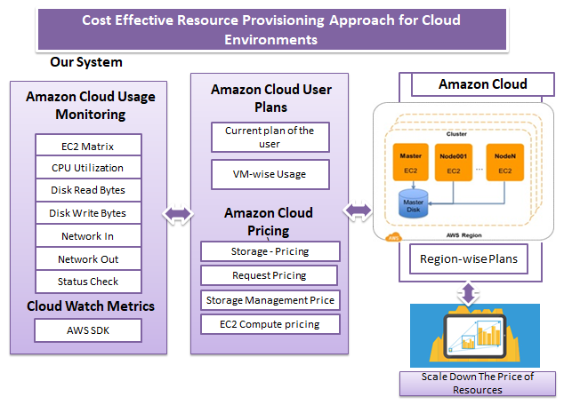
Architecture

Slide 12
Project Scope
The proposed system which cans monitor VMs (EC2 Instances) on private clouds such as Amazon or Google and offers solutions to decrease infrastructure cost. Resource Monitoring of Cloud Nodes:
1. Cloud Setup - Creating private cloud (test bed) by using (Amazon Account).
2. Resource Monitoring - monitoring critical resources like RAM, CPU, memory,
bandwidth, partition information, running process information and utilization and swap usages etc.
3. Authentication and authorization – we need to connect to existing user’s amazon account using user id and password and fetch all the performance matrix like CPU, RAM, storage etc.
4. Testing - In order to evaluate the performance of complete setup, need to deploy resource monitoring and load balancing tools on test bed and evaluate need of available resources.
Modules:
1. Resource Monitoring of Cloud Nodes:
User should be able to view CPU and RAM usage utilization of amazon ec2 nodes
CPU and RAM utilization statistics should be dynamic and should refresh every second.

Slide 13
2. Select Cloud Plans for popular clouds like amazon. Cost of service depends on region of server, memory usage, CPU etc. Cloud service providers charge for following services which need to be added in system
a. Storage – Pricing
b. Request Pricing
c. Storage Management Price
d. CPU pricing
3. Monitor account wise VM Usage of following parameters
a. CPUUtilization
b. DiskReadBytes
c. DiskWriteBytes
d. NetworkIn
e. NetworkOut
StatusCheck
4. Propose efficient resource utilization
a. By suggesting memory cutdown
b. By suggesting cpu cutdown
c. By suggesting storage cutdown

Slide 14
Algorithm
a. AES Algorithm
AES is based on a design principle known as a substitution-permutation network, and is fast in both software and hardware.[8] Unlike its predecessor DES, AES does not use a Feistel network. AES is a variant of Rijndael which has a fixed block size of 128 bits, and a key size of 128, 192, or 256 bits. By contrast, the Rijndael specification per se is specified with block and key sizes that may be any multiple of 32 bits, both with a minimum of 128 and a maximum of 256 bits.
AES operates on a 4×4 column-major order matrix of bytes, termed the state, although some versions of Rijndael have a larger block size and have additional columns in the state. Most AES calculations are done in a special finite field.
The key size used for an AES cipher specifies the number of repetitions of transformation rounds that convert the input, called the plaintext, into the final output, called the cipher text. The number of cycles of repetition are as follows:
• 10 cycles of repetition for 128-bit keys.
• 12 cycles of repetition for 192-bit keys.
• 14 cycles of repetition for 256-bit keys.

Slide 15
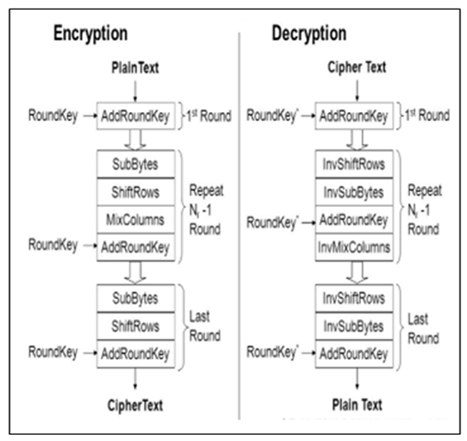
Each round consists of several processing steps, each containing four similar but different stages, including one that depends on the encryption key itself. A set of reverse rounds are applied to transform cipher text back into the original plaintext using the same encryption key.

Slide 16
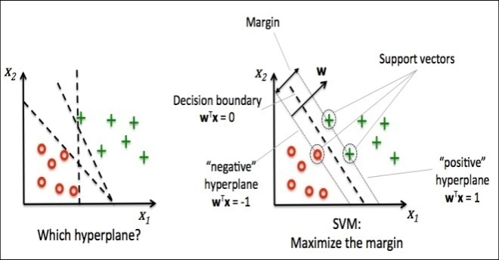
Support Vector Machine (SVM)
• SVM is a powerful classifier that is able to distinguish two classes. SVM classifies the test image in to the class with highest distance up to the neighboring point in the training.
• SVM training algorithm built a model that predict whether the test image fall into this class or another.
• SVM necessitate a vast training data to decide a decision boundary and computing cost is very high although we are using single pose (frontal) detection.
• The SVM is a learning algorithm for classification which attempt to discover the finest distinguishing hyper plane which minimize the error for unseen patterns.
Figure 1 : Distinguishing Hyper Plane To Minimize The Error
The data which cannot be distinguished the input is mapped to high-dimensional attribute space where they can be separated by a hyper plane. This projection is well performed by means of kernels.

Slide 17
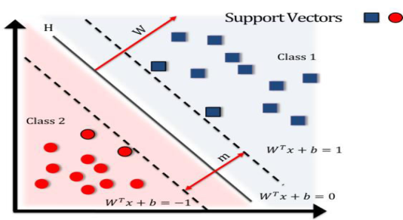
Figure 2: Separating Hyper Plane By Equation
• If training set of samples and the equivalent resultant values {-1, 1}. So SVM intend to get the best separating hyper plane specified by the equation WTx+b that make use of the distance between the two classes as shown in above figure.

Slide 18
Advantages
The proposed system give the suggestions about cost optimization and delivering cost containment.
The key advantage of the system is to give the suggestions about cost optimization and delivering cost containment.

Slide 19
Software
• IDE : Eclipse Luna
• Database : MYSQL
• Platform : Microsoft Windows 7 Professional or greater
• Language : Java JDK 1.8

Slide 20
Hardware
• Processor : 1 gigahertz (GHz) or faster processor or SoC.
• RAM : 1 gigabyte (GB) for 32-bit or 2 GB for 64-bit.
• Hard Disk Space: 16 GB for 32-bit OS 20 GB for 64-bit OS)

Slide 21
Application
1. The application is used for providing suggestions about cost optimization and delivering cost containment.
2. Used in monitoring and analyzing cost pattern on cloud accounts.

Slide 22
References
Ryan Chard,Kyle Chard,Rich Wolski,Ravi Madduri,Bryan Ng and Kris Bubendorfer,IanFoster,"Cost-AwareCloudProﬁling,Prediction,andProvi- sioning as a Service", PUBLISHED BY THE IEEE COMPUTER SOCIET, 2017.
Xinhui Li, Ying Li, Tiancheng Liu, Jie Qiu, Fengchun Wang,"The Method and Tool of Cost Analysis for Cloud Computing",2009 IEEE International Conference on Cloud Computing.
G.Anuprabavathi1, R.Rajmohan2, J.Nulyn Punitha3, D.Dinagaran4, S.G.Sandhya ,“ENERGY-EFFICIENT AND COST-EFFECTIVE RESOURCE PROVISIONING FRAMEWORK FOR MAP REDUCE WORKLOADS USING DCC ALGORITHM”, International Journal of Engineering Science Invention Research & Development; Vol. II Issue IXMarch2016.
Amelie Chi Zhou, Bingsheng Heand Cheng Liu Nanyang Technological University "Monetary Cost Optimizations for Hosting Workﬂow-as-a-Service in IaaS Clouds", IEEE TRANSACTIONS ON CLOUD COMPUTING, VOL. X, NO. X, AUGUST 2014.

Slide 23
Faiza Samreen, Gordon S Blair, Yehia Elkhatib “Joint Optimization of Computational Cost and Devices Energy for Task Offloading in Multi-Tier Edge-Clouds” IEEE-2020.
Elie El Haber, Student Member, IEEE, Tri Minh Nguyen , Student Member, IEEE, and Chadi Assi , Senior Member, IEEE “Joint Optimization of Computational Cost and Devices Energy for Task Offloading in Multi-Tier Edge-Clouds” IEEE TRANSACTIONS ON COMMUNICATIONS, VOL. 67, NO. 5, MAY 2019.

